Slide 1
Live Classroom
Module 5 –Analysis of Variance

Slide 2
Topics
One-way ANOVA
Pairwise comparisons
Dummy variable creation
One-way ANCOVA
LS means
Two-way ANOVA
Interaction Plots

Slide 3
Introduction
Earlier in the class, we looked at a way to compare means between two groups.
But what if we have more than 2 groups?
ANOVA (Analysis of Variance) can do this.
General term which involves breaking down variability in a particular continuous outcome into pieces.
It involves comparing the variability after accounting for a characteristic versus the remaining variability.
We’ll first talk about one factor (one-way ANOVA), and then we’ll discuss understanding the role of two factors at the same time.

Slide 4


One-Way ANOVA
Seek to make comparisons across several groups.

Slide 5
One-Way ANOVA
Commercials aired on TV entice potential buyers to consider purchasing specific brand of golf balls by claiming increased driving distances. In order to see which brand of golf balls is best (as measured by distance travelled), an experiment is set up where a mechanical driver (to improve precision and consistency between hits) hits 5 balls of each of three brands. The distance in yards achieved after each strike is measured.

Slide 6
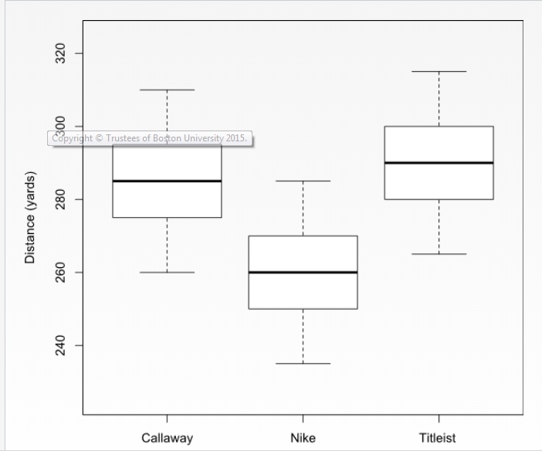
One-Way ANOVA

Slide 7
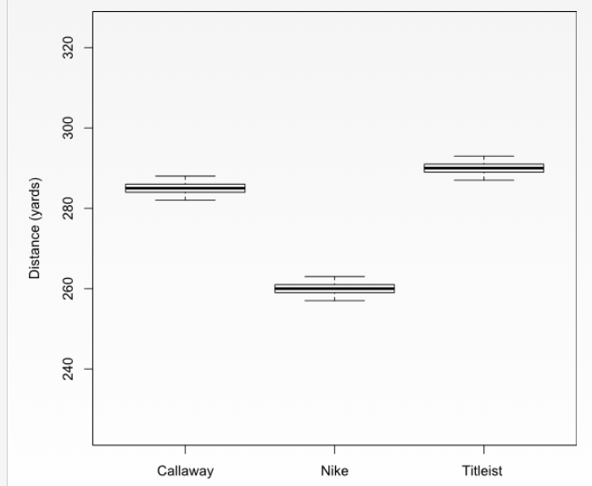
One-Way ANOVA

Slide 8
One-Way ANOVA
In general, if the variability between groups is small relative to the variability in the measurements within groups, we are less inclined to conclude that there is a difference between them.
On the other hand, if the variability between groups is large in comparison to the variability within each individual group, it is easier to see and conclude that there is a difference.

Slide 9
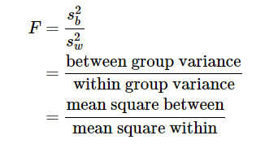
One-Way ANOVA
df = k-1 and n-k
The between group variance measures how far the group means are from the overall mean (across all groups).
The within group variance measures the variation among individuals in the same group.

Slide 10
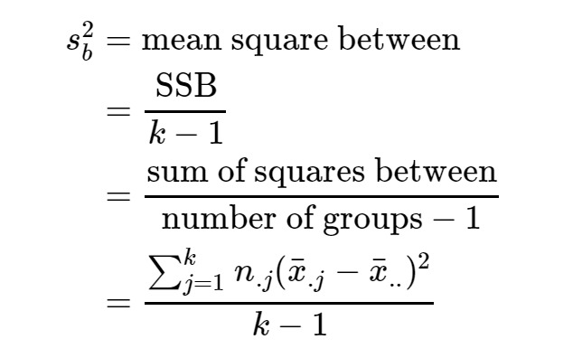
One-Way ANOVA

Slide 11
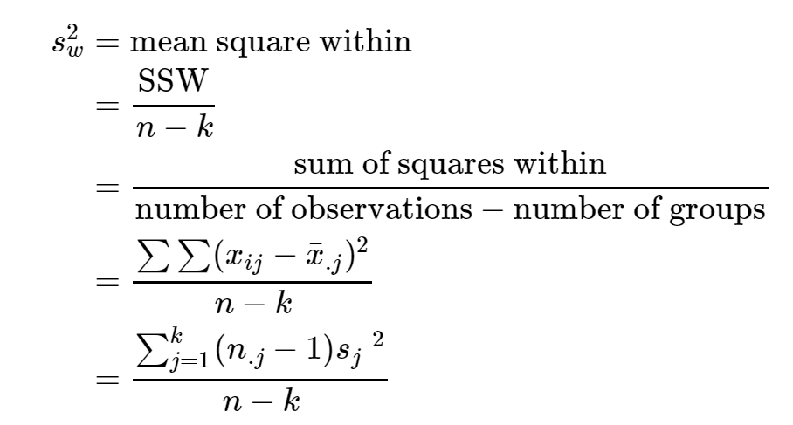
One-Way ANOVA

Slide 12
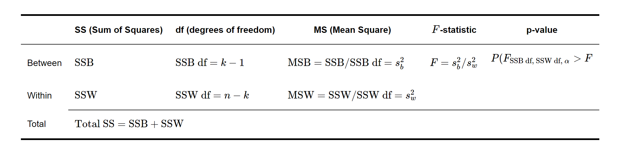
One-Way ANOVA
In ANOVA, the F-test derived from the ANOVA table is sometimes referred to as the global test.
For this test, we use the ANOVA table and are interested in testing that at least two of the groups have underlying means that are different from each other.
If this test confirms that there are at least two groups with different means, then subsequent tests can be used to assess which groups have differing underlying means.

Slide 13
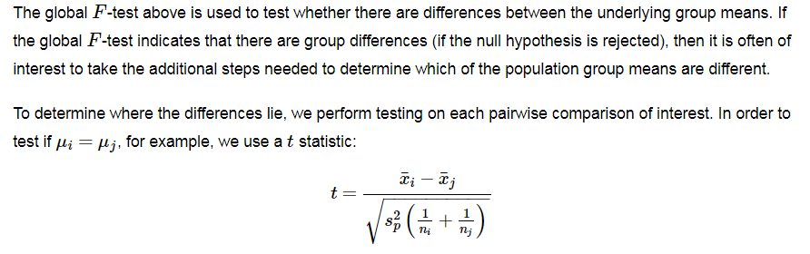

Evaluating Group Differences
Df = n-k
Equal to MSW

Slide 14
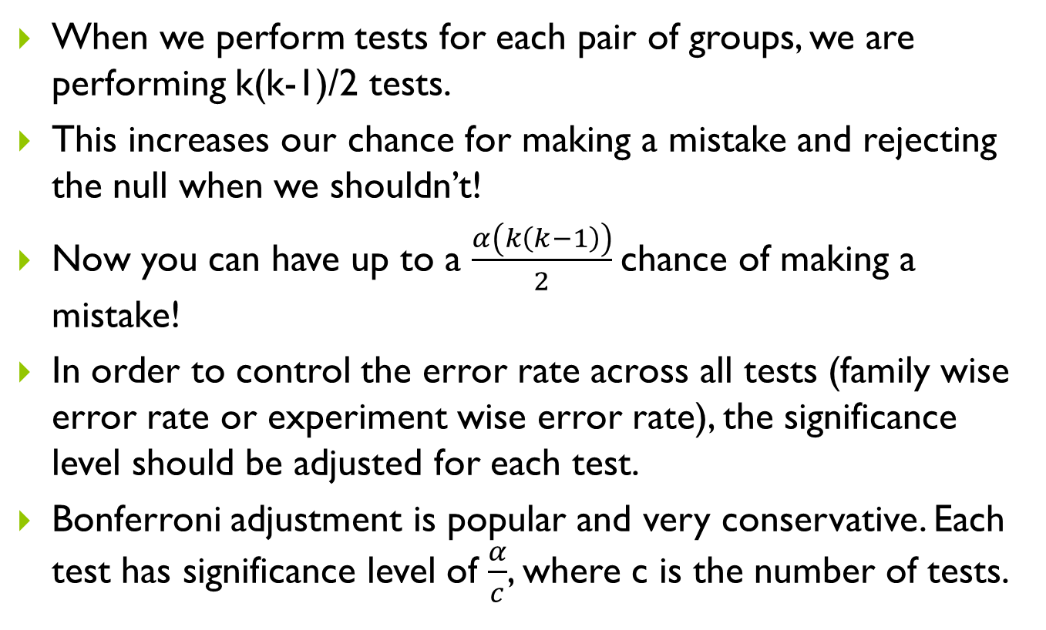
Issues with Multiple Comparisons
When we perform tests for each pair of groups, we are performing k(k-1)/2 tests.
This increases our chance for making a mistake and rejecting the null when we shouldn’t!
Now you can have up to a $\frac{α\left(k\left(k−1\right)\right)}{2}$chance of making a mistake!
In order to control the error rate across all tests (family wise error rate or experiment wise error rate), the significance level should be adjusted for each test.
Bonferroni adjustment is popular and very conservative. Each test has significance level of $\frac{α}{c}$, where c is the number of tests.

Slide 15
Assumptions of ANOVA
Independent, random samples from each group.
Outcome of interest in each group is normally distributed.
Outcome of interest in each group has a similar unknown standard deviation.
** ANOVA is fairly robust with departures from normality. Large sample sizes are preferred if distributions do not look normal.
**ANOVA is also fairly robust from equal standard deviations (especially if sample sizes are similar across groups). Largest sample sd should be no larger than 2 times as large as the smallest sample sd.

Slide 16
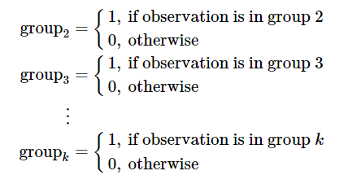
Relationship between One way ANOVA and Regression
We can use linear regression to conduct the same test.
The explanatory variable indicates group membership.
Need to create k-1 dummy variables!

Slide 17
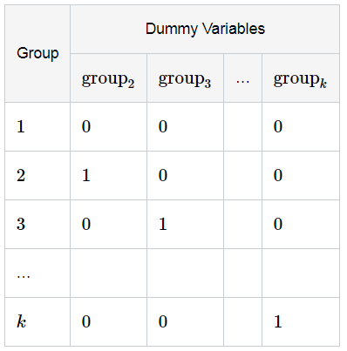

Relationship between One way ANOVA and Regression
Need to create k-1 dummy variables!

Slide 18
One-way ANOVA
Use the aov() function
m<-aov(data$response~data$group)
summary(m)
Note: group must be a factor for this to work
If overall model is significant, then use pairwise.t.test to compare means
pairwise.t.test(data$response, data$group, p.adj = “method")
Note: method = "holm", "hochberg", "hommel", "bonferroni", "BH", "BY", "fdr", "none“
TukeyHSD(m)

Slide 19
One-way ANOVA
Alternatively, can use lm() function with dummy variables
m2<- lm(data$response~data$dummy1+data$dummy2…)
summary(m2)
This is equivalent to the overall model using the aov statement, but requires the creation of dummy variables

Slide 20
Dummy variable creation
Indicator variables for each level of a grouping factor
Regression requires k-1 dummy variables (one less than the number of levels of the variable)
Level that is not included is the reference group
Can use the ifelse() function
ifelse([condition], [value if true], [value if false])
data$dummy0<-ifelse(data$group == 0, 1, 0)

Slide 21
Example – SBP by smoking status
A random sample of current light smokers, current heavy smokers, former smokers, and those who have never smoked was taken to determine if mean systolic blood pressure differs across smoking status categories.

Slide 22
Example – SBP by smoking status
Check if grouping variable (smoking status in this case) is a factor
is.factor(data$Group)
If result is FALSE, you need to create factor variable
data$grp<-factor(data$Group, levels = c(0,1,2,3)) Note: levels controls the ordering
Numerical and Graphical Summaries (Modules 1 and 2)
Calculate mean, SD of SBP by smoking status
Box Plots
Perform one-way ANOVA and if necessary (based on the results), calculate the associated pairwise comparisons
m<-aov(SBP~grp, data = data)
summary(m)
pairwise.t.test(data$SBP, data$grpnew, p.adj = "bonferroni")
TukeyHSD(m)

Slide 23
Example – SBP by smoking status
Creation of dummy variables
data$g0<-ifelse(data$Group == 0, 1, 0)
data$g1<-ifelse(data$Group == 1, 1, 0)
data$g2<-ifelse(data$Group == 2, 1, 0)
data$g3<-ifelse(data$Group == 3, 1, 0)
One-way ANOVA using lm() function
m2<-lm(SBP~g0+g1+g2, data = data)
summary(m2)
m3<-lm(SBP~g1+g2+g3, data = data)
summary(m3)
m4<-lm(SBP~g0+g2+g3, data = data)
summary(m4)

Slide 24
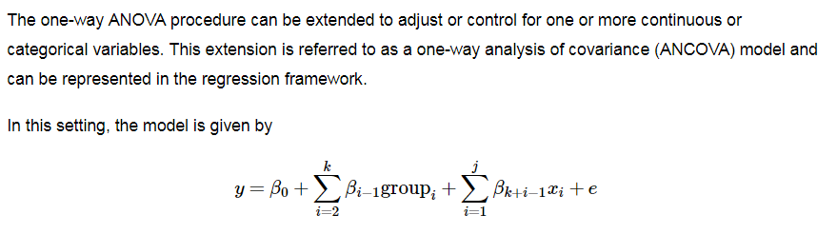
One-Way ANCOVA
Mainly interested in results of overall model, as well as the results of the grouping factor.
First, perform global test! If it’s significant, move on to individual test for group.
Report lsmeans (or adjusted means) for each group.

Slide 25
One-way ANCOVA
Do not use aov() function as it will not produce expected output
Need to use Anova() function from car package to get “Type III” sums of squares
install.packages(“car”)
library(car)
options(contrasts=c("contr.treatment","contr.poly"))
Anova(lm(data$response~data$group+data$covariate), type=3)

Slide 26
One-way ANCOVA
Generate Least Squares means (Covariate adjusted means) and comparisons
install.packages("lsmeans")
library(lsmeans)
options(contrasts=c("contr.treatment","contr.poly"))
lsmeans(lm(data$response~data$group+data$covariate), pairwise ~ group, adjust=[method])
Note: method = "tukey" , "scheffe“, "sidak" , "bonferroni“, "dunnettx" "mvt”, “none”

Slide 27
Example – SBP by smoking status
Re-run ANOVA adjusting for Age
library(car)
Anova(lm(SBP~grp+Age, data=data), type=3)
Least Square Means
library(lsmeans)
options(contrasts=c("contr.treatment","contr.poly"))
lsmeans(lm(SBP ~grp+Age, data=data), pairwise ~ grp, adjust = "none")

Slide 28
Two-way ANOVA
Use Anova() function
Anova([model], type=3)
First test interaction model
Use model = lm(data$response~data$group1+data$group2+data$group1*data$group2)
Visualize relationship using interaction.plot() function
interaction.plot(data$group1, data$group2, data$Response)
Then, if p-value for the interaction is not significant, then can run regular two-way ANOVA
Use model = lm(data$response~data$group1+data$group2)

Slide 29
Example – Scores by Gender and Birthday
Test Interactions
Anova(lm(Reading~bday+gender+bday*gender, data=data),type = 3)
Anova(lm(Math~bday+gender+bday*gender, data=data),type = 3)
Generate Interaction plots
interaction.plot(data$bday, data$gender, data$Math, xlab = "Birthday Month", ylab="Mean Math Score", trace.label = "Gender")
interaction.plot(data$bday, data$gender, data$Reading, xlab = "Birthday Month", ylab="Mean Reading Score", trace.label = "Gender")

